Slide 1
Introduction to EurAqua
“A water-science network at the service of Europe".

Slide 2












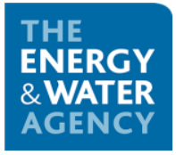







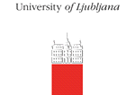



European coverage
(1)
(2)
(3)
(4)
8
(5)
(
(8)
6)
22
19
(9)
(
13
23
10)
(11)
(12)
18
16
(13)
(16)
15
(14)
(15)
4
7
6
9
(18)
(19)
(20)
12
2
(
17)
25
21
11
1
(
24
26
21)
(22)
(23)
(24)
5
10
(25)
(26)
17
3
20
14
Notes:
Please add the Dublin logo (see earlier mail this afternoon)
Maybe use this slide as first slide, so that people can see it when coming in.

Slide 3
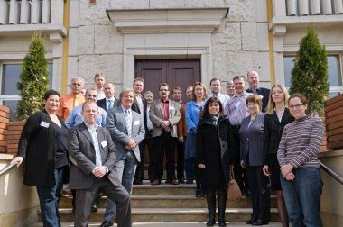
Membership
EurAqua Partner institutions are leading, generally public, freshwater research institutions in the EU Member States and the European Economic Area.
They tend to
Be key advisors to ‘water
management’ ministries and
other regional water authorities
Have an international profile
Link to water management
industry
General rule: 1 member/ country
BUT within the country, EurAqua members are closely connected to other relevant institutions.
Management board meeting in Warsaw, 2011
Notes:
Change the picture to a meeting in Dublin or Oslo, see folder.

Slide 4
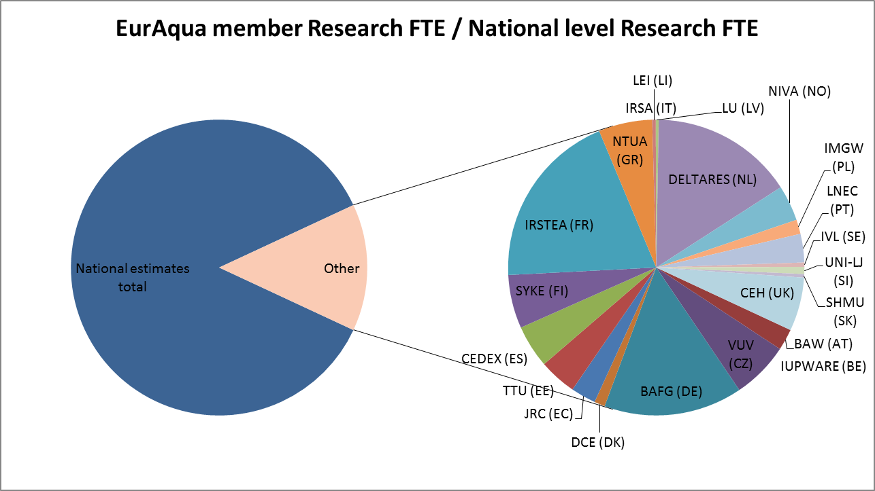
Includes Research Institutes and Universities
Excludes consultancy and water authorities
Notes:
Michiel 4/6/2019: do not include this slide

Slide 5
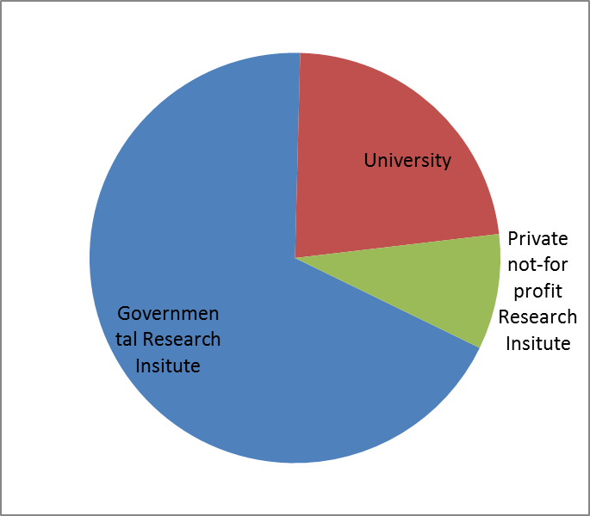
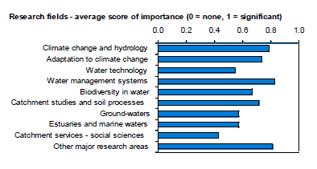
Profile (continued)
Not included FTE counts
Notes:
Since 2008, Vituki seized to exist, EAWAG decided to termintate its membership. NERI merged with University of Aarhus.
Should we update this figure, and if so, how?
Michiel 4/6/2019: do not include this slide

Slide 6
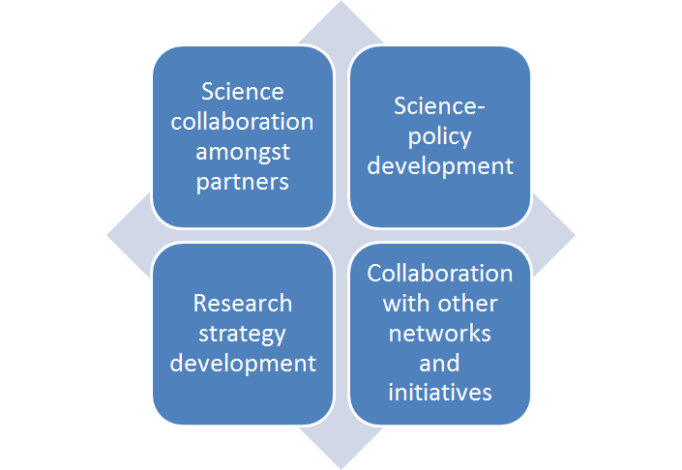
Mission statement
To contribute to the development of European freshwater science and technology as well as to its dissemination on a European scale.
EurAqua's actions therefore aim to play a significant role in the development of the scientific and economic basis of European water management.
To this end, 4 main types of strategic actions (Figure on the right)
EurAqua's strategic actions.
Notes:
4/6/2019 Michiel Ommit?: To this end, 4 main types of strategic actions (Figure on the right)

Slide 7
Strategic Action 1: Science collaboration amongst partners
Project setting and development
  EurAqua's partners have been involved in more than 80 EU projects (Framework Programme, joint programming initiatives, Structural Funds or COST)
Knowledge sharing and dissemination
  EurAqua Conference: How can climate change be incorporated in river basin management plans under the WFD? (2008)
  EurAqua Symposium "Impact of climate change on water resources — 200 Years hydrology in Europe — a European perspective in a changing world“ (2010)
  Innovative approaches for the management of environmental risks from plant protection products. A joint EurAqua-PEER Scientific Conference (2010)
  Joint EurAqua – WssTP workshop: Water-related ecosystem services [ESS] – increasing the relevance of the concept for operational management on various scales (2014)
Notes:
Max 2 examples everywhere? Otherwise people get distracted too much?

Slide 8
Strategic Action 2: Research strategy development at the EU level
Identification and validation of RDI needs. A few examples:
  Paper on priority research needs to better achieve the objectives of the Water Framework Directive (presented at the EU Commission in 2018)
  Contribution to the update of the strategic agenda of the Water JPI (2019)
Write-up of position papers and responses to open consultations; examples:
  Specific programme of Horizon2020
  Priority issues for the Horizon2020 work programme on Societal Challenge 5: Climate action, resource efficiency and raw materials
  Outline of the European Innovation Partnership on Water
  Need of a network of hydrological observatories (Responding to: Possible topics for future activities for integrating and opening national research infrastructures)
  Along with the EU Water Alliance, proposal for a water mission within the frame of Horizon Europe
Notes:
(presented at the EU Commission in 2018)
Replace by: Presented to DG RTD, DG ENV and SCG-CIS
Max 2 examples everywhere? Otherwise people get distracted too much?

Slide 9

Strategic Action 3: Science-policy development
Meetings with members of the European Commission
  DG ENV
  DG Agriculture
  DG RTD
Meetings with members of the European Parliament
Purpose of these meetings:
  Presentation of EurAqua activities --- enhanced visibility at the EU level
  Identification of potential collaboration activities (ex: identification of RDI needs for achieving the objectives of the WFD, 2017-2018)
Notes:
DG AGRI (not full name, or all full name)
I am not aware of meetings with EP

Slide 10
Strategic Action 4: Collaboration with other networks and initiatives
Formalized MOUs
  Partnership for European Environmental Research (PEER)
  Water Supply and Sanitation Technology Platform (WssTP)
Observership
  Common Implementation Strategy (CIS) for the WFD
  JPI Water Challenges (Stakeholder Advisory Group)
  Rhine Commission
  In preparation / informal: HelCom; Europe-Inbo; MenBo; ICPDR
EU Water Alliance
  ‘ad hoc’ network of umbrella organisations: Aqua Europa, EWP, WssTP, EurEau, Aqua publica europea, EurAqua, ACQUEAU, EWA, NetwercH2O
The intention is to step-up on inter-network collaborations
Support any of the other strategic actions (bridging science policy interfacing, identification of RDI needs, project set-up and development) and bring forward EurAqua's expertise at the European level
Notes:
International Commission for the Protection of the Rhine
Baltic Marine Environment Protection Commission (Helcom) [I think we are observer]
Leave out inbo, menbo ICPDR

Slide 11
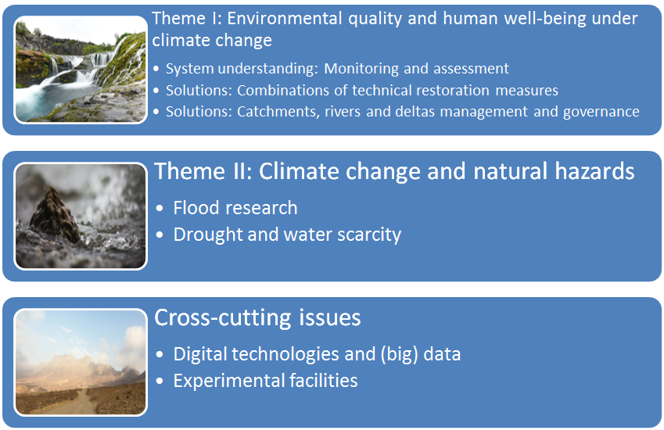
EurAqua's strategic agenda
It sets out RDI areas where collaboration amongst members will be sought through either internal (in-kind) or external funding (Framework Programme, JPIs, COST, etc.). Its content is built around EurAqua members' institutional programmes.
Collaboration will translate into:
the launch of projects;
mobility actions;
peer-reviewed papers;
science-policy, or
infrastructure sharing.
RDI themes laid out in
EurAqua's strategic agenda.

Slide 12
Thank you for your attention
Contact: euraqua@deltares.nl
www.euraqua.org
Notes:
Note that full membership is open to EurAqua Partner institutions that are leading, generally public, freshwater research institutions in the EU Member States and the European Economic Area.

